Slide 1

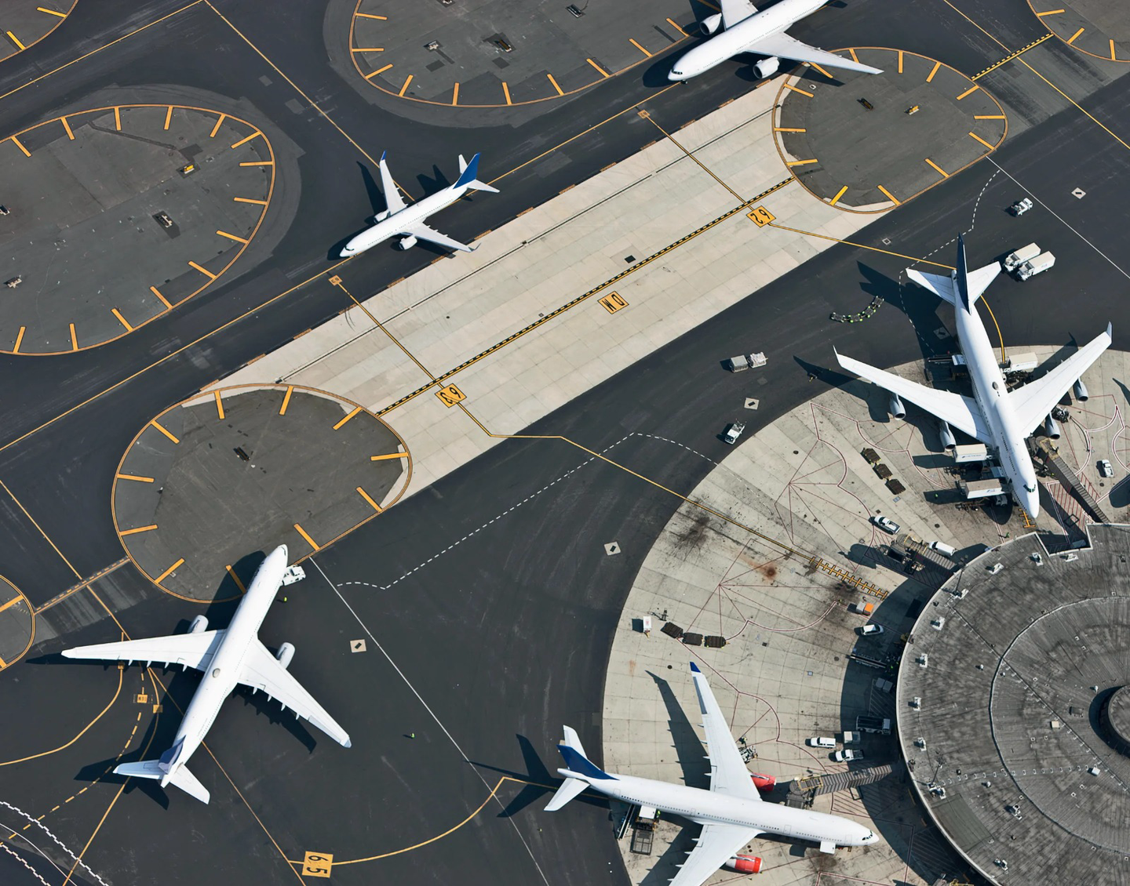
PREDICTING AND ANALYZING U.S. FLIGHT DELAYS
Presented by :
Hema Puchakayala
Hussain Nathani
Rasika Shrikant Nilatkar
Sayam Palrecha

Slide 2



Which Airline Santa shouldn’t take ?
JetBlue Airways
United Airlines
American Eagle Airlines
American Airlines
U.S
Airways
Notes:
Which flight santa shouldn't take? (Midterm conclusion)
JetBlue Airways
United Air Lines Inc.
American Eagle Airlines Inc.
American Airlines Inc.
US Airways Inc.

Slide 3
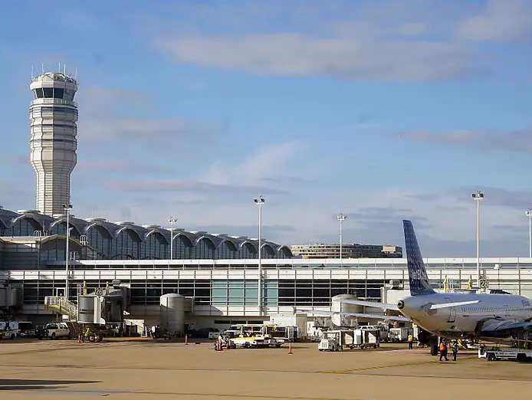
DATA CLEANING
01
Null handling
02
Outliers removed
Normal distribution check
03

Slide 4



SMART Q1
For the for the top 5 most delayed airlines, can we predict the total arrival delay using machine learning models for proper resource allocation and planning.

Slide 5

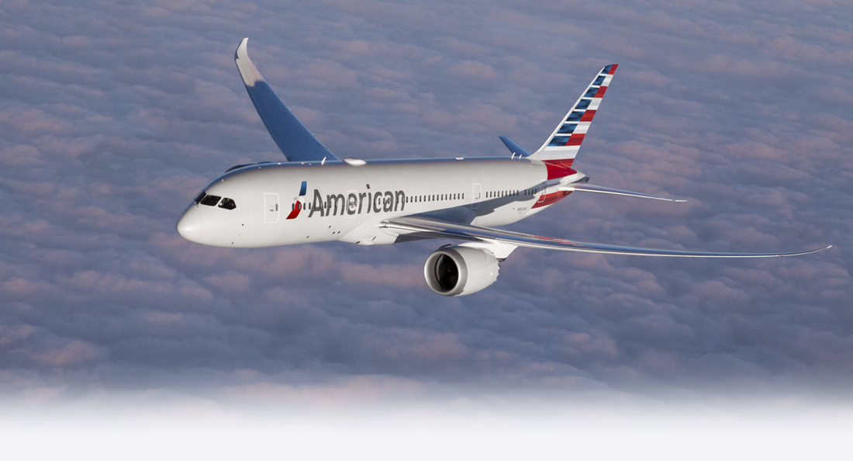
DELAY REASON
~60%
Late aircraft delay
~25%
Carrier delay
~15%
NAS delay

Slide 6


FEATURES
Day of the week
Departure time, Departure delay
Air travel time
Distance travelled
Taxi In and Taxi Out time
Flight information
Departure and arrival airports

Slide 7

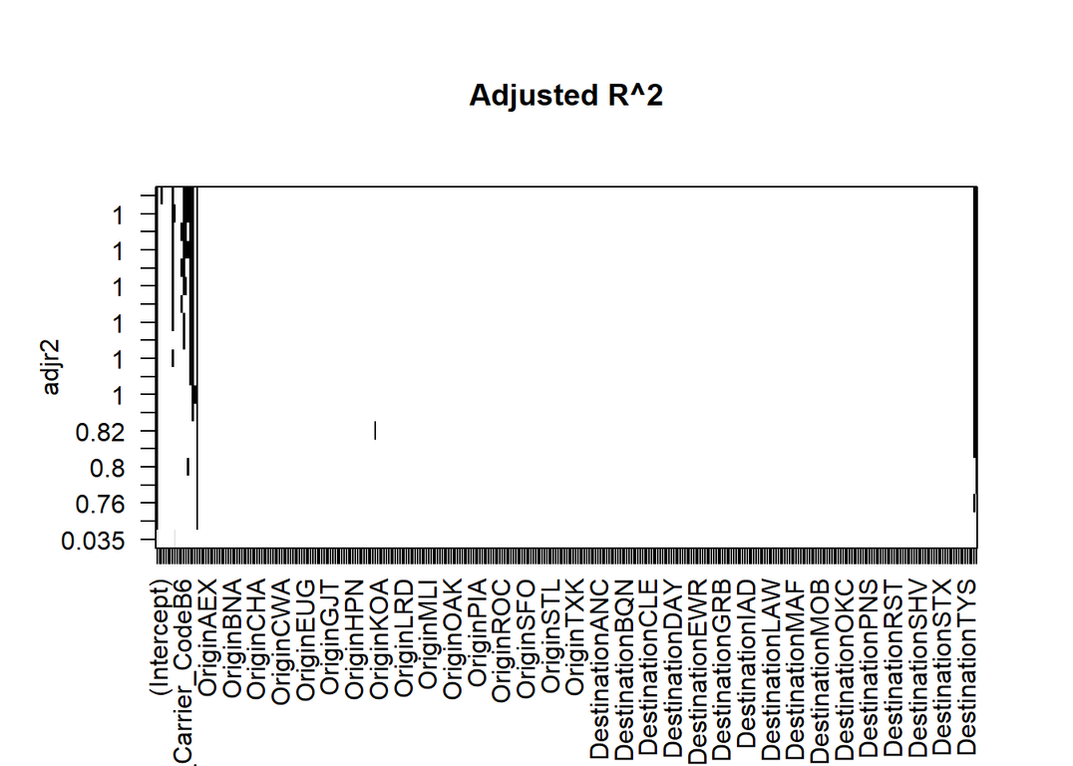
FORWARD
FEATURE SELECTION
Estimated_Elapsed_Time_min
Air_Time_min
Departure_Delay_min
Taxi_In_min
Taxi_Out_min

Slide 8

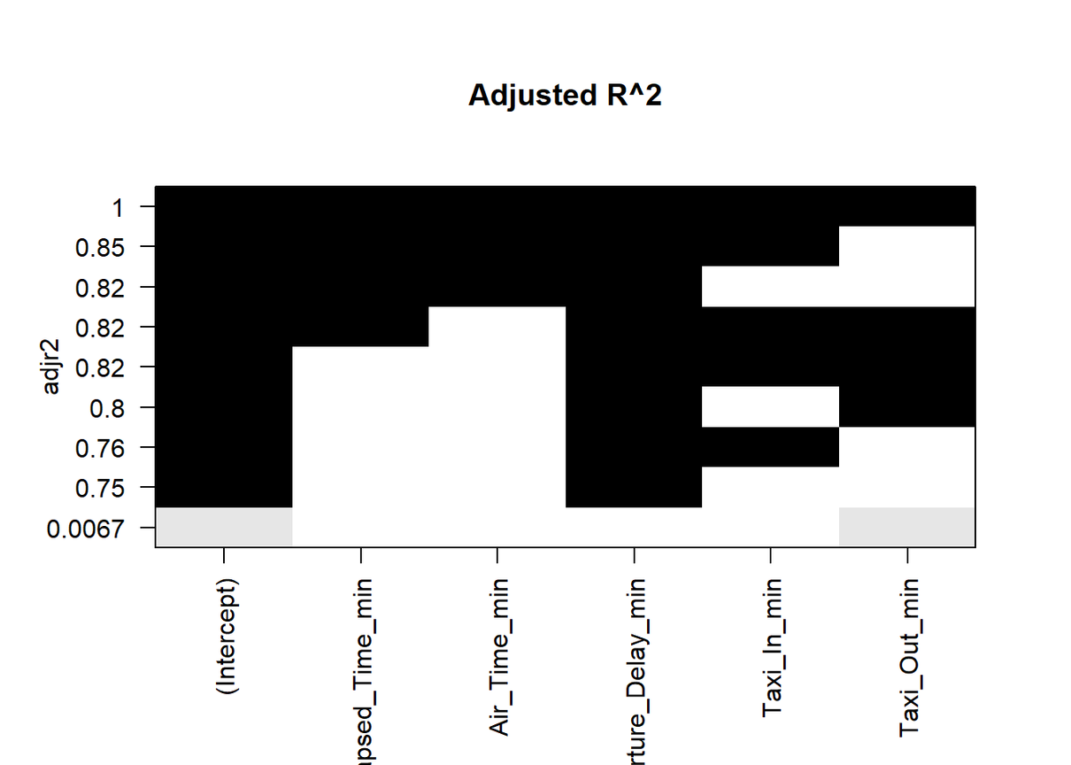
BASE MODEL
Multi collinearity
Over fitting

Slide 9
VIF Values
AIR_TIME_MIN (67)
DEPARTURE_DELAY_MIN (1.23)
ESTIMATED_ELAPSED_TIME_MIN (67.8)
TAXI_IN_MIN (1.06)
TAXI_OUT_MIN (1.22)

Slide 10
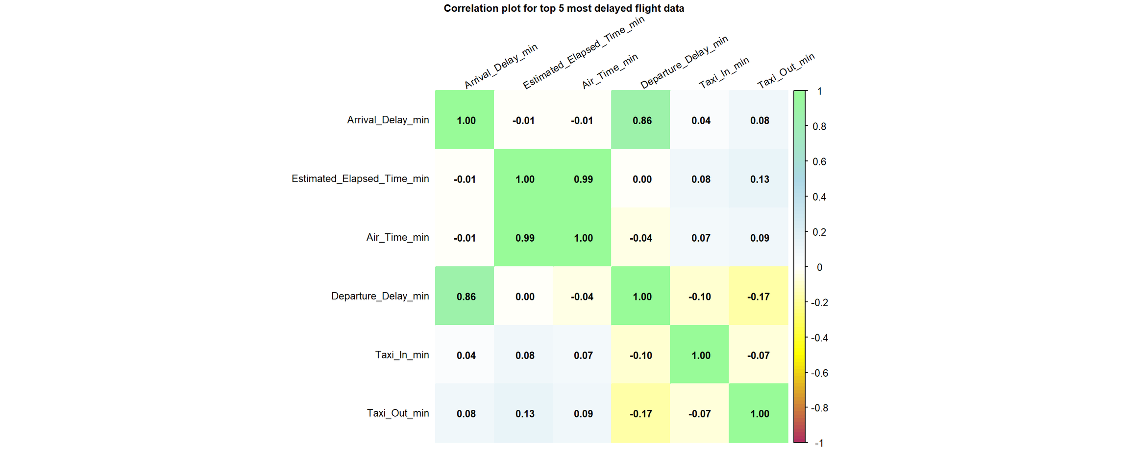
CORRELATION PLOT

Slide 11

LINEAR MODELS
MODEL1
MODEL2
MODEL3
Features:
Departure Delay
R² : 74.5%
All features significant
P-value < 0.05
F-statistic: 4.39e+05
Features:
Departure Delay
Taxi_Out_min
R² : 80.3%
All features significant
P-value < 0.05
F-statistic: 2.03e+05
Features:
Departure Delay
Taxi_Out_min
Taxi_In_min
R² : 82.3%
All features significant
P-value < 0.05
F-statistic: 7.28e+04

Slide 12
VIF values < 10 for the 3 models
Air_Time_mins causing multi collinearity
Estimated_Elapsed_Time_min doesn’t significantly improve R²
Model2 and Model3 are good

Slide 13
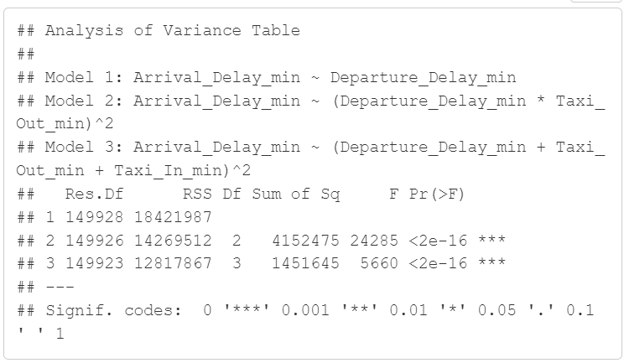
ANOVA RESULTS

Slide 14



MSE & RMSE
MODEL 2
MODEL 3
Training:
MSE - 95.2
RMSE - 9.76
Testing
MSE - 95
RMSE - 9.75
Training:
MSE - 85.6
RMSE - 9.25
Testing
MSE - 85.2
RMSE - 9.23

Slide 15

CONCLUSION
Optimize operational efficiency
Reduce costs
Improve resource allocation
Enhance predictive maintenance

Slide 16
SMART Q2
Using logistic regression model to predict flight delays (>15 minutes) for major U.S. carriers during summer months (June-August) and the correlation it has with the time of the day

Slide 17
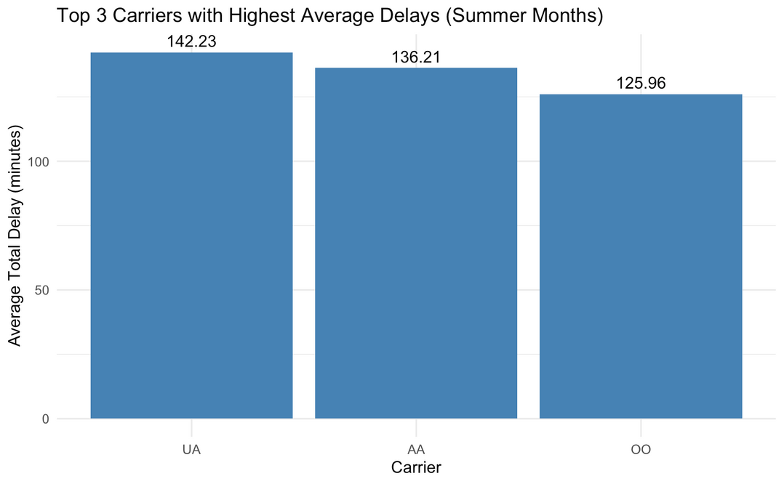
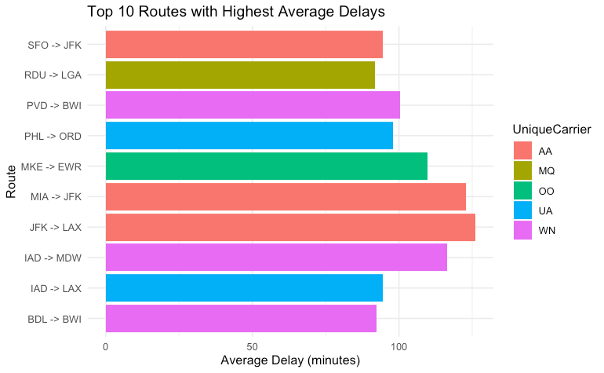
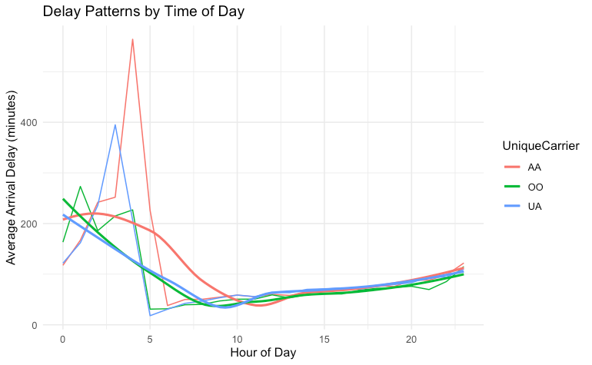
RECAP OF THE EDA
Previously, I covered:
Top 3 carriers
Top 10 routes
Delay patterns by time of the day

Slide 18
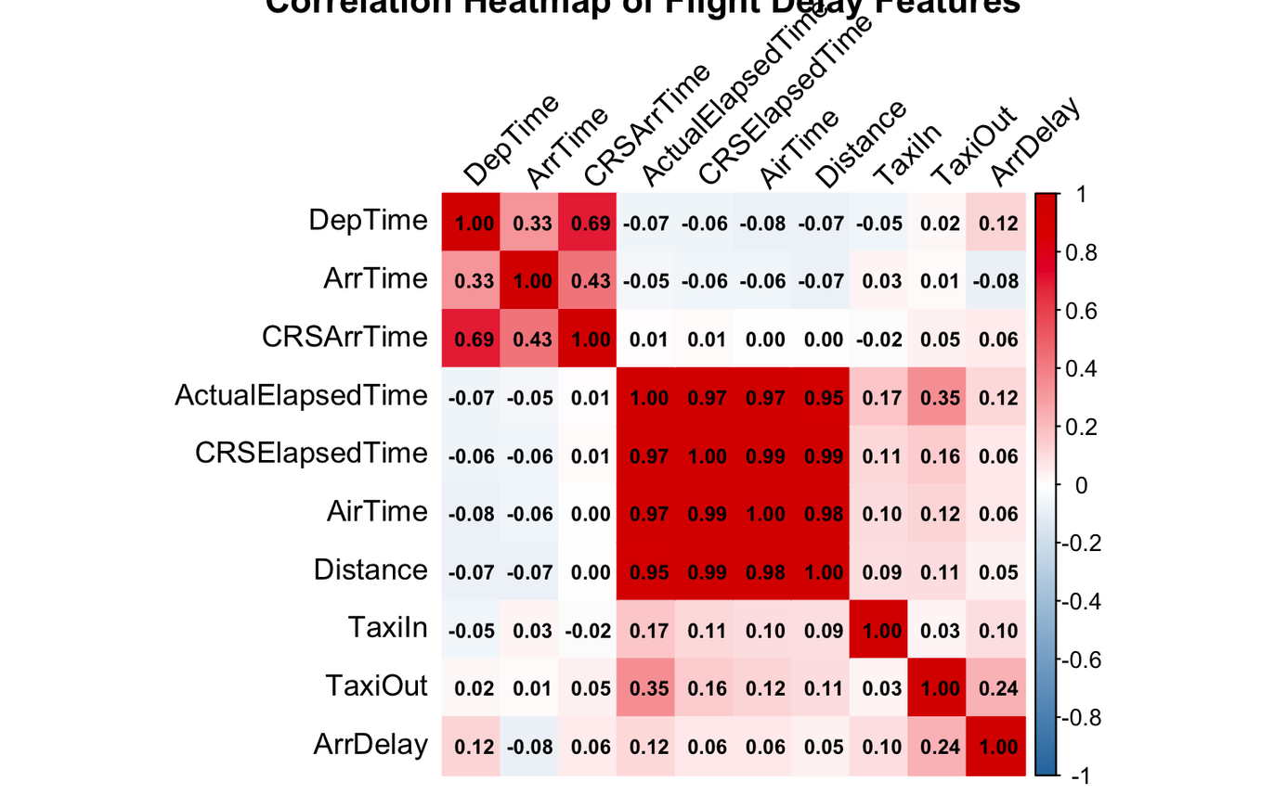
CORRELATION WITH THE DELAY
Pearson correlation to understand the correlation of various numerical features
This helps us to understand the various factor that lead to the delay of a flight
These were next used to create models and run ANNOVA test

Slide 19
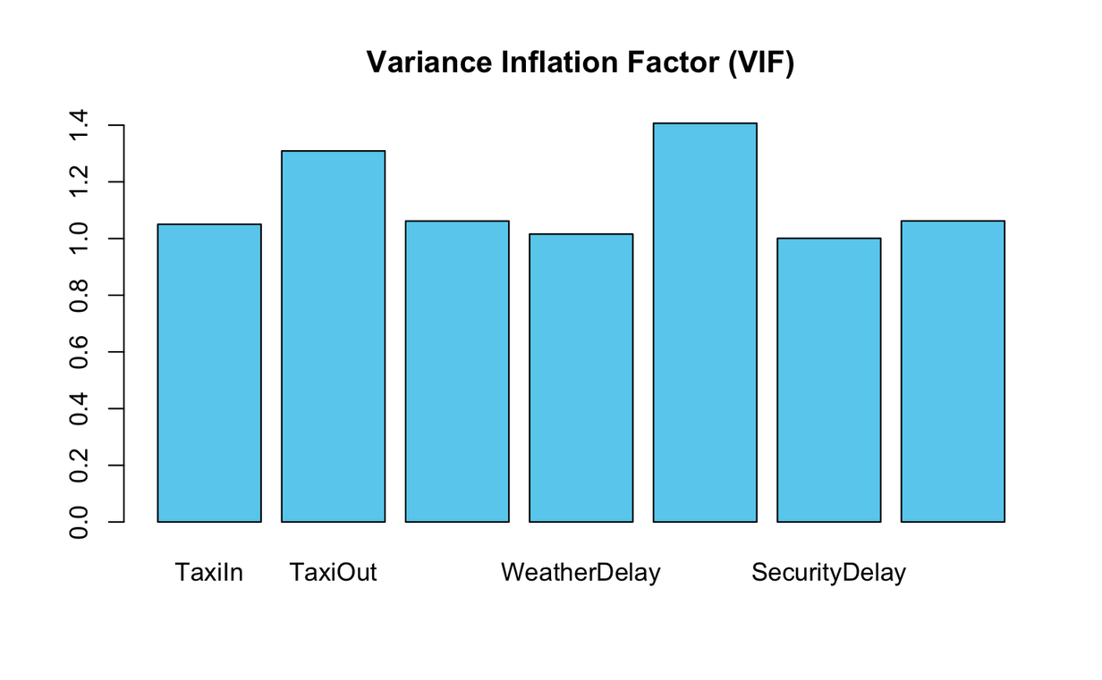
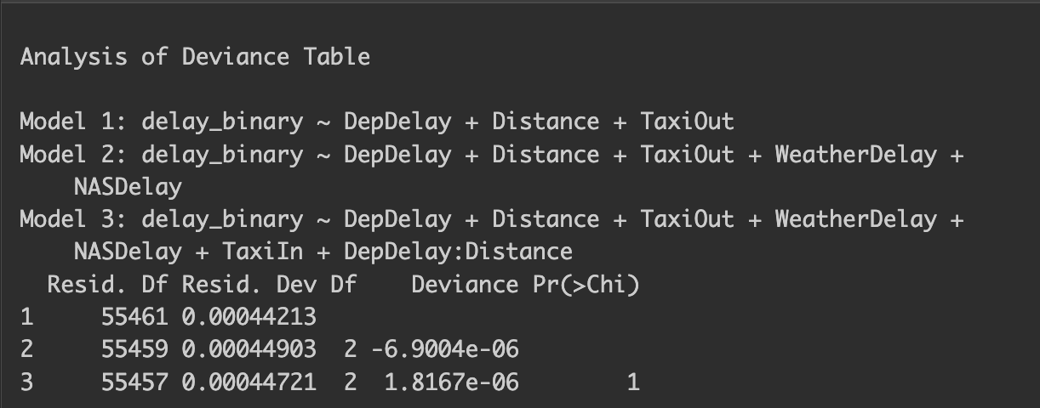
MULTICOLLINEARITY CHECK
VIF table shows no features with high correlation have a vif>5
Which shows low multicollinearity
ANNOVA test showed that after model 1 and model 2 and 3 did not show a very high increase in the performance of the model

Slide 20
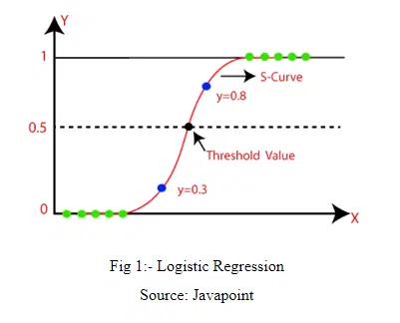
WHY USE LOGISTIC REGRESSION ?
Binary Outcome Prediction: Logistic regression is specifically designed for binary classification
Interpretability: The model provides clear interpretable
Probability Output: The model provides probability scores for delays rather than just classifications
Handles Multiple Features: The model effectively manages multiple input variables

Slide 21
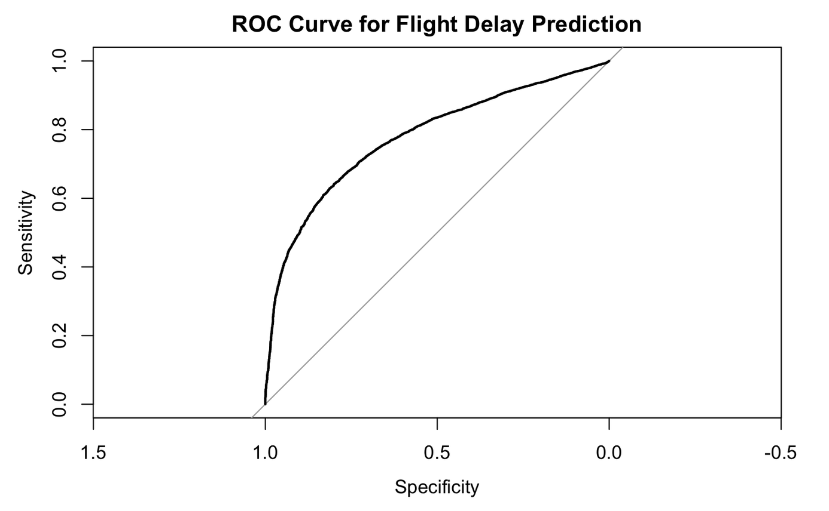
FINAL RESULTS AND INTERPRETATION
• Overall Accuracy: 88.15%
• Confidence Interval: (87.76%,88.53%)
Confusion Matrix
Prediction | 0 | 1
0 | 81 | 259
1 | 3027 | 24356

Slide 22

SMART Q3
What are the significant factors influencing total flight delays across the top 10 busiest U.S. airports over the observed period, and how do these factors vary by season?

Slide 23
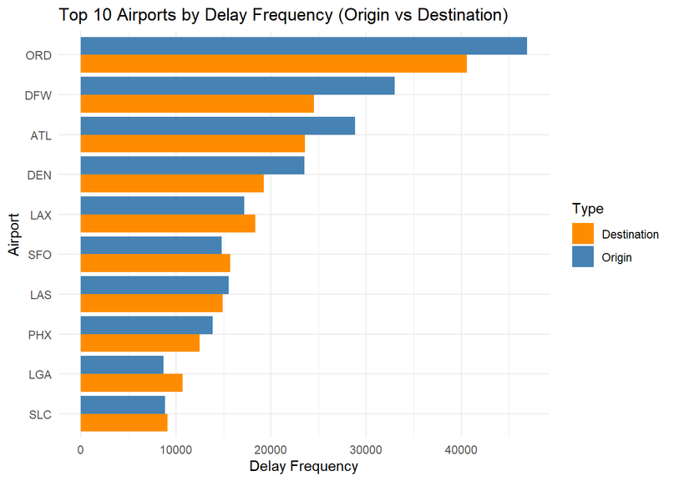
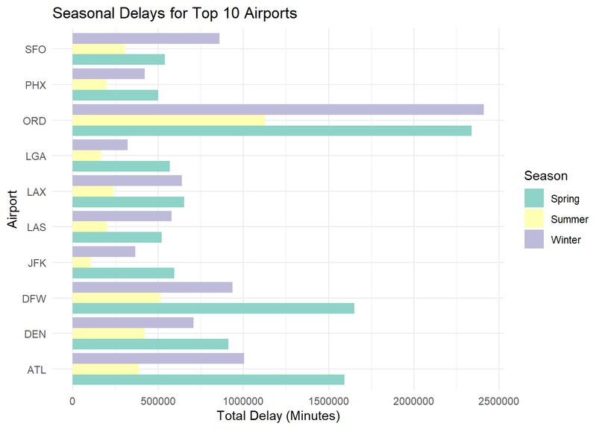
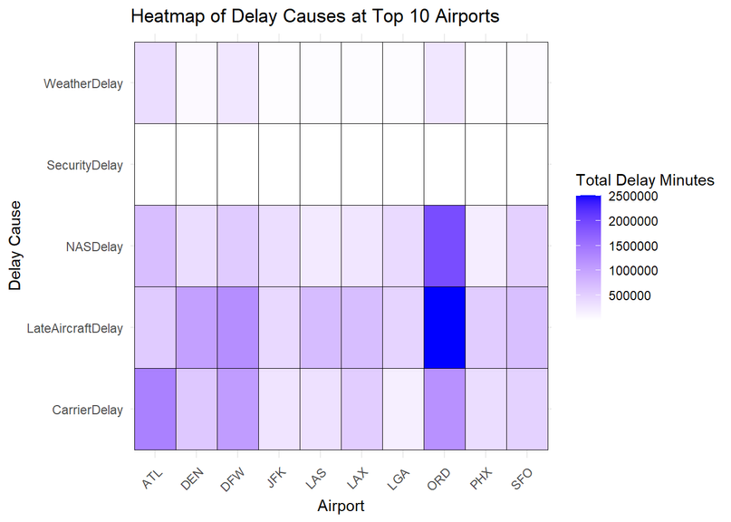
Recap of EDA
Which are the top airports by delay frequency?
Most delay in which season?
What are the most delaying causes at top airports?

Slide 24


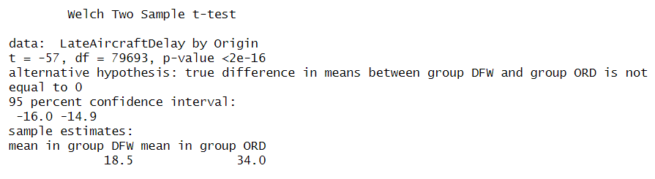
Welch T-Test: Comparing Delays Between Airports
Result:
-> Mean delay (ORD): 34.0; Mean delay (DFW): 18.5.
-> t-value: -57, p-value: < 2e-16 (significant difference).
ORD experiences significantly higher delays than DFW.
Similarly significant difference are present between other airports.

Slide 25
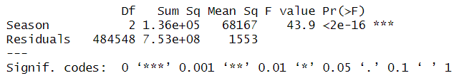
ANOVA: Comparing Delays Across Seasons
Result:
-> F-value: 43.9, p-value: < 2e-16 (significant differences).
Season significantly impacts delays.

Slide 26
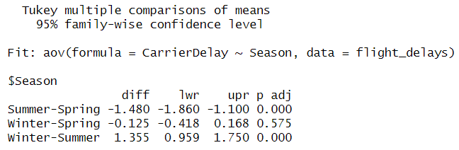
Tukey HSD:
Seasonal Differences
Result:
-> Summer vs. Spring: Difference: -1.48, p-value: < 0.001.
-> Winter vs. Summer: Difference: 1.36, p-value: < 0.001.
-> No significant difference between Winter and Spring.
Season significantly impacts delays.

Slide 27
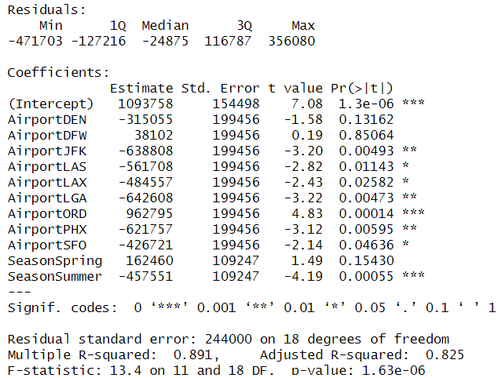
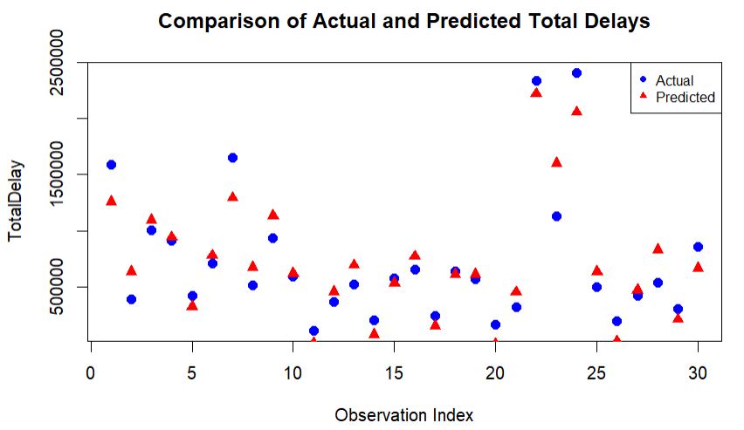
Linear Regression Model
Adjusted R-squared: 0.825 (good fit).
Significant predictors: ORD (high delays), JFK, LGA (low delays), Summer (fewer delays).
Model Evaluation:
-> Mean Squared Error (MSE): 3.58e+10.
-> Root Mean Squared Error (RMSE): 189,221.
The model performs reasonably well in explaining and predicting delays.

Slide 28
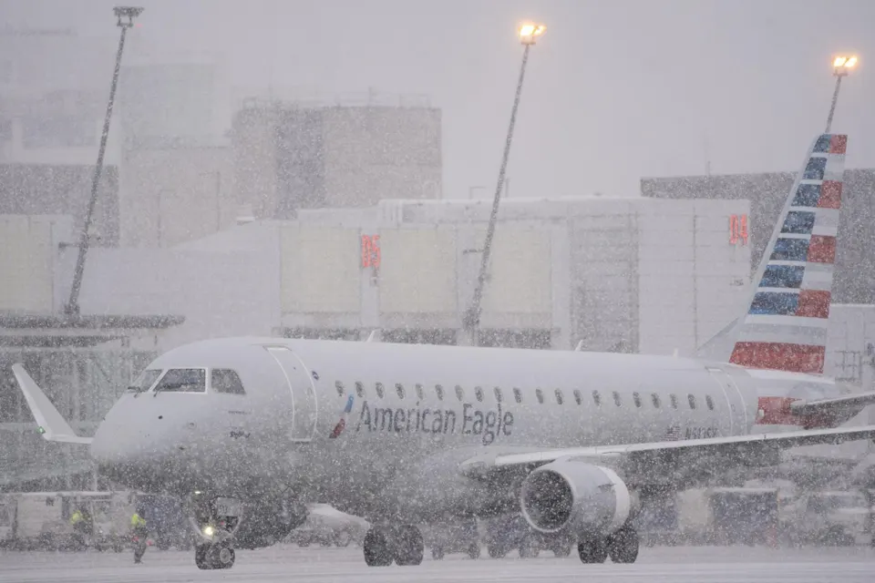
CONCLUSION
Significant Factors: Late Aircraft, NAS, and Carrier Delays are primary contributors.
Seasonal Variations: Winter sees higher delays, while Summer has fewer delays.
Airport-Specific Insights: ORD and DFW face higher delays, while JFK and LGA are more efficient.
Recommendations for Authorities:
Resource allocation in peak Winter season
Seasonal strategies
Infrastructure upgrade
Use delay predictions to inform passengers

Slide 29
SMART Q4
Can we predict the probability and duration of flight delays based on the time of day and type of delay, including factors like NAS, Security, and Late Aircraft?

Slide 30
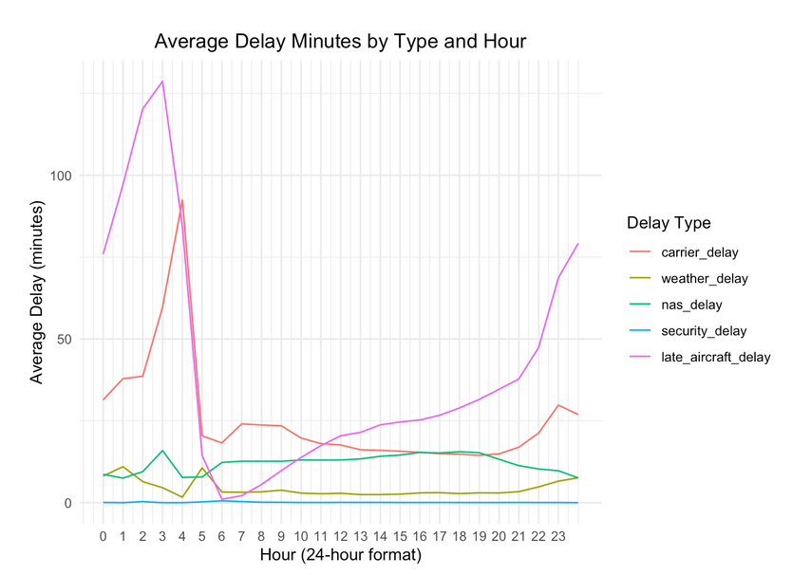
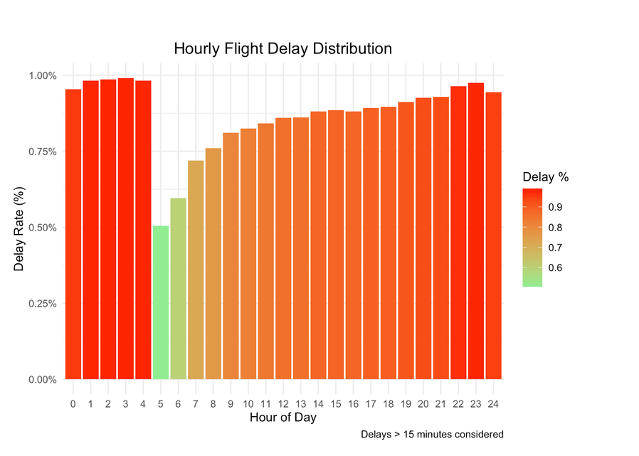
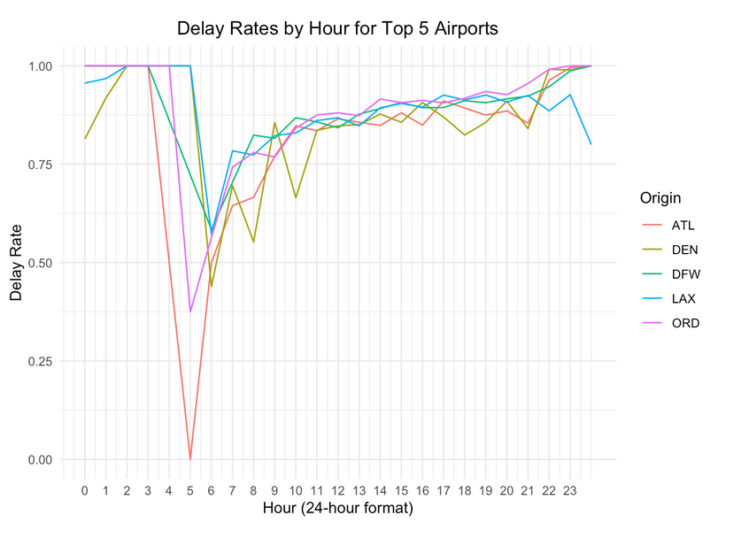
Recap of EDA
Types of Delay by hour -
Overall Delay Pattern by hour -
Top Airport Delay Analysis -

Slide 31
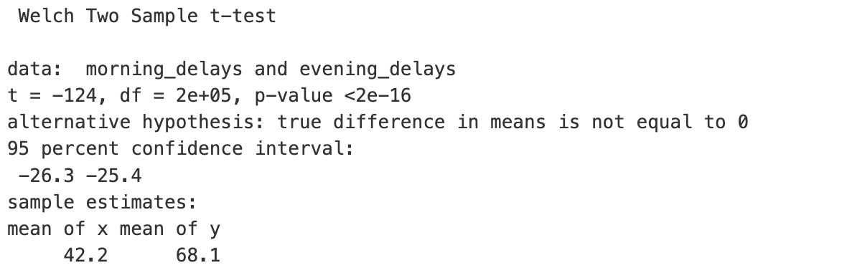
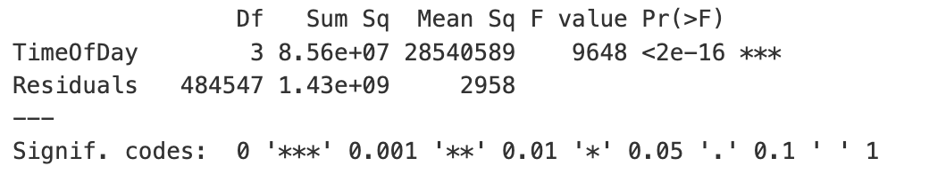
Sample T-Test
ANOVA Test

Slide 32
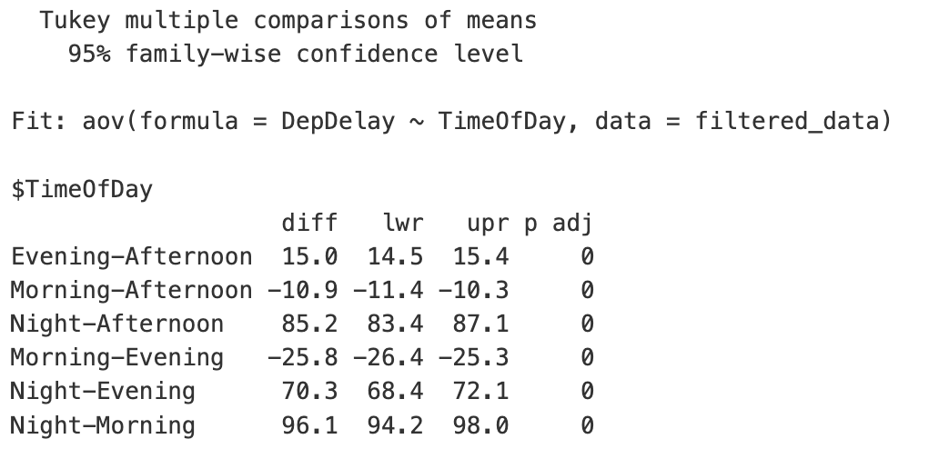
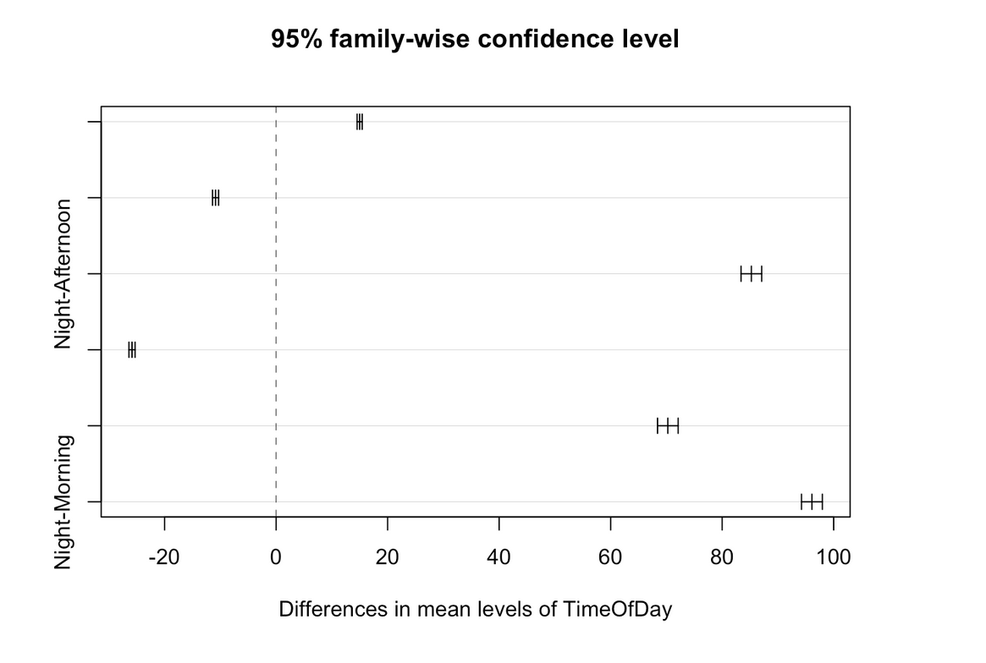
Tukey HSD Test
Most confidence intervals are far from zero, indicating statistically significant differences between the compared groups.
Night-Morning - significant positive difference.
Night-Afternoon - strong positive difference, suggesting higher delays at Night compared to Afternoon.

Slide 33
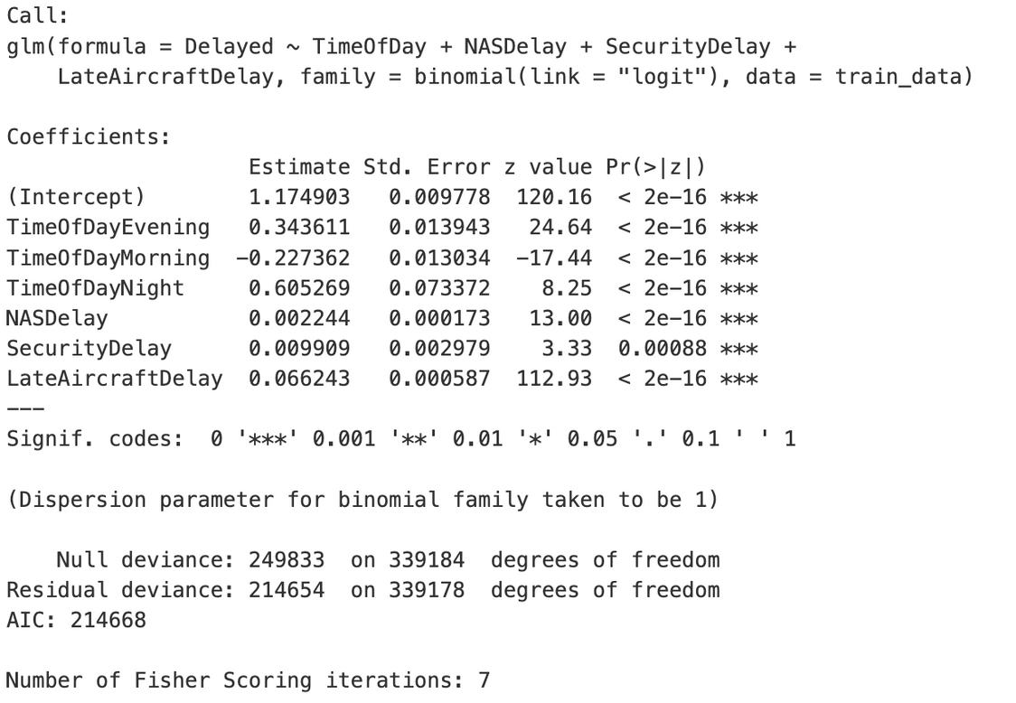
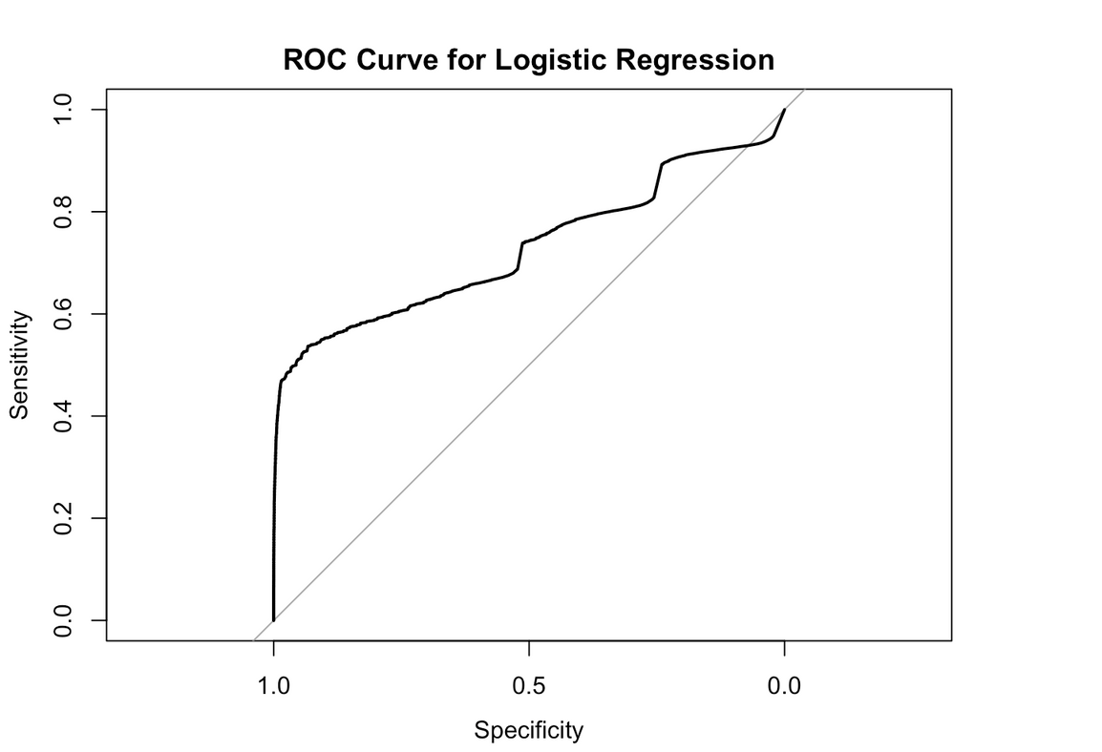
Logistic Regression for Delay Probability
AUC - 0.728

Slide 34
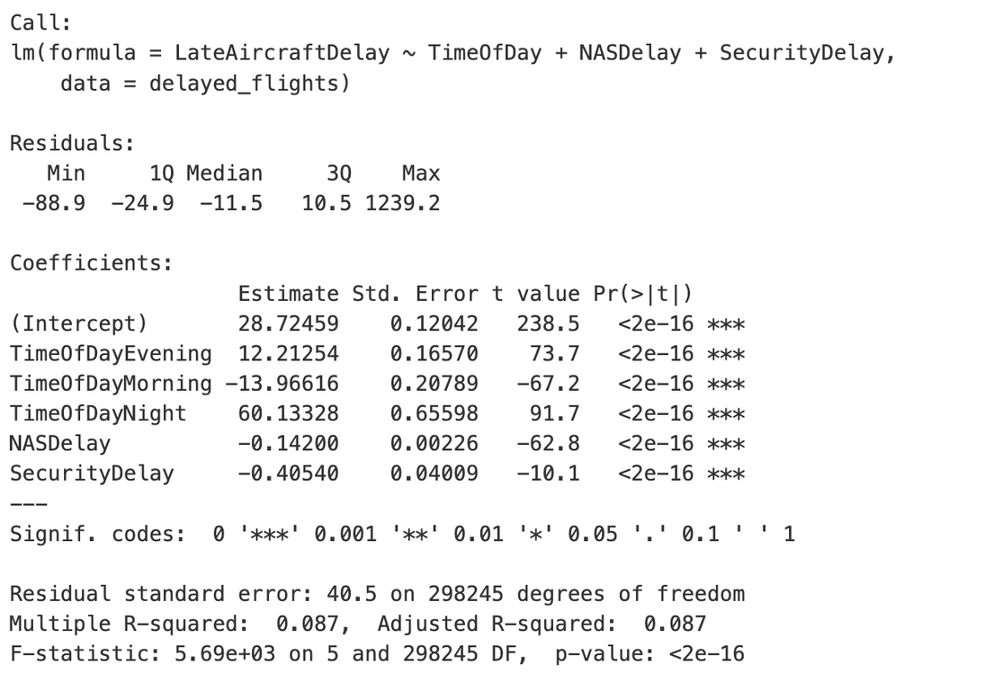
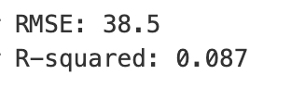
Linear Regression: Predicting Delay Duration

Slide 35
CONCLUSION
Focus on reducing turnaround times for late-arriving aircraft.
Manage NAS-related congestion during peak hours.
Opt for Morning flights.

Slide 36

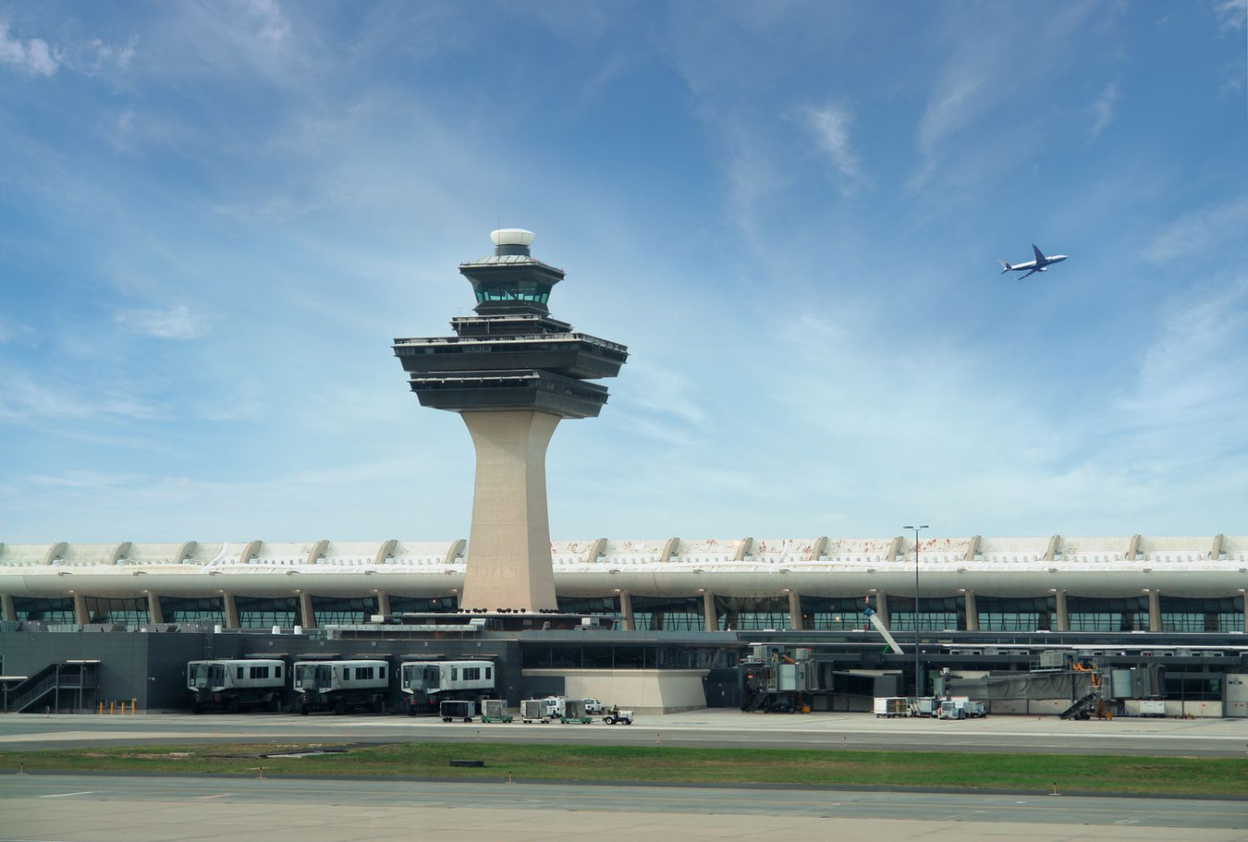
Thank You!
Let’s all book for vacations!

